Slide 1

[Samsung PRISM] End Review Report
AI, ML | AUDIO SOURCE SEPARATION
OD91IIITK
Team
College Professor
Dr. K. Krishna Naik
Samsung Mentors
Arun D Prabhu
Sukumar Manohar
Students
Avula Ankith Reddy
Hassan Muhammed Ahsan
Ramniwash Kumar
31st Aug 2021

Slide 2


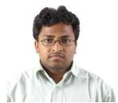
Information Retrieval | AI, ML | Audio Source Seperation
Problem Statement
Identifying and extracting tracks of individual instruments from a given audio snippet is a challenging task and has applications in many fields like entertainment, advertisement, etc. It is very useful to music producers and DJs who can isolate the tracks and edit easily.
Given an audio snippet, the task is to identify the different instruments used and extract the tracks of those instruments.
The network must extract a variety of features like the durations, key signatures, timing and polyphonic texture information.
Expectations
Understanding of Machine learning algorithms for classification
Generating training and testing data using public and Samsung provided resources
Develop a noise type classifier to identify the noise type of each noisy media title in the training set with accuracy > 90%
Training/ Pre-requisites
Trained in Tensorflow, Java, Flutter
Completed Courses:
Tensorflow
Machine Learning
Audio Processing
Student Learning
Discrete Understanding of Model and Algorithm.
Audio Seperation Engine Usage.
Design Linear and Iterative Models.
Test Driven Development.
Project Repository:
Audio Source Seperation :
https://github.ecodesamsung.com/SRIB-PRISM/IIITK_OD91IIITK_Audio_Source_Separation
Kick Off < Month 1>
Understanding audio seperation
Research on Audio source separation pre trained model and java based app.
Milestone 1 < Month 2 >
Basic Select Statements to Audio Source Separation with model and datasets and App.
Milestone 2 <Month 3>
App completed and Audio classification model made using UrbanSound8K dataset.
Milestone 3 <Month 4>
Developed an audio source separation model which is based on a UNet Architecture.
Arun D Prabhu, Engineer
arun.prabhu@samsung.com
+91-94494120795
Sukumar Moharana, Architect
msukumar@samsung.com
+91-9886198665
Notes:
-

Slide 3
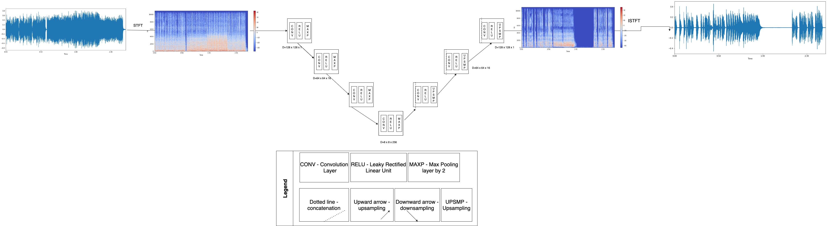
Approach / Solution
Concept Diagram :

Slide 4
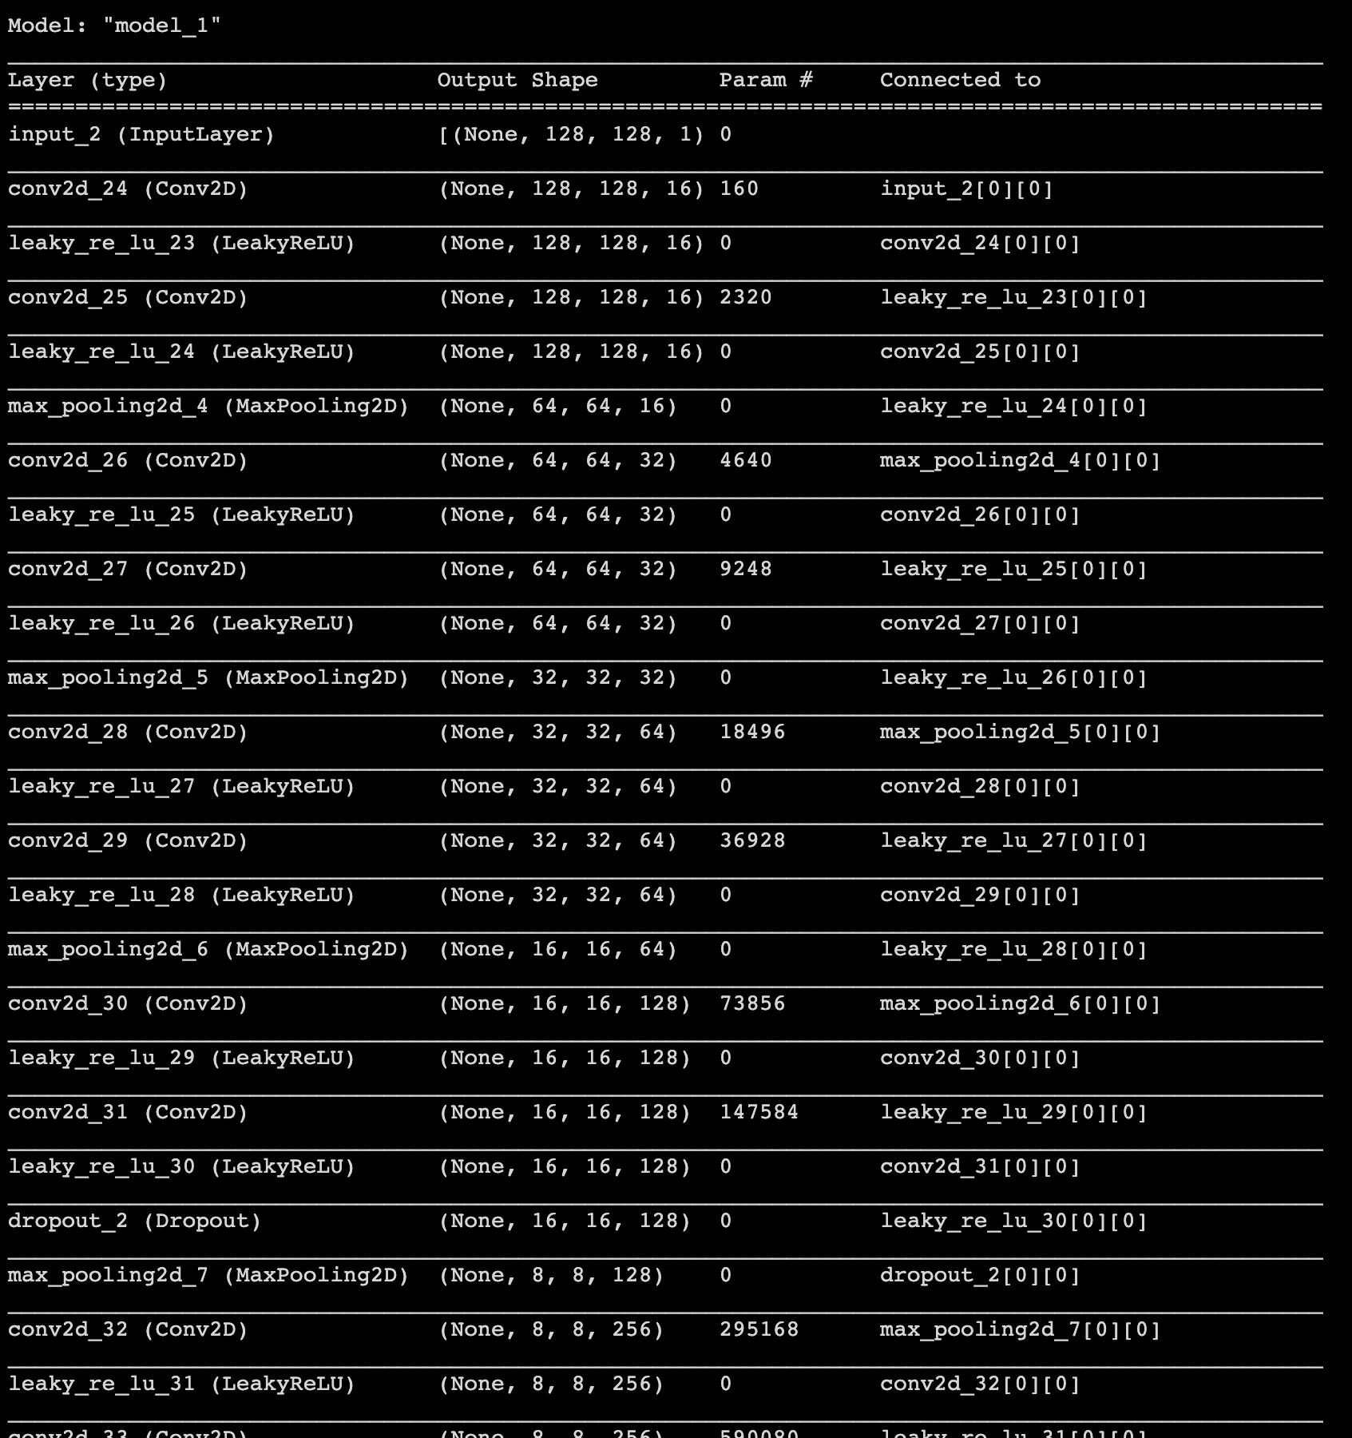
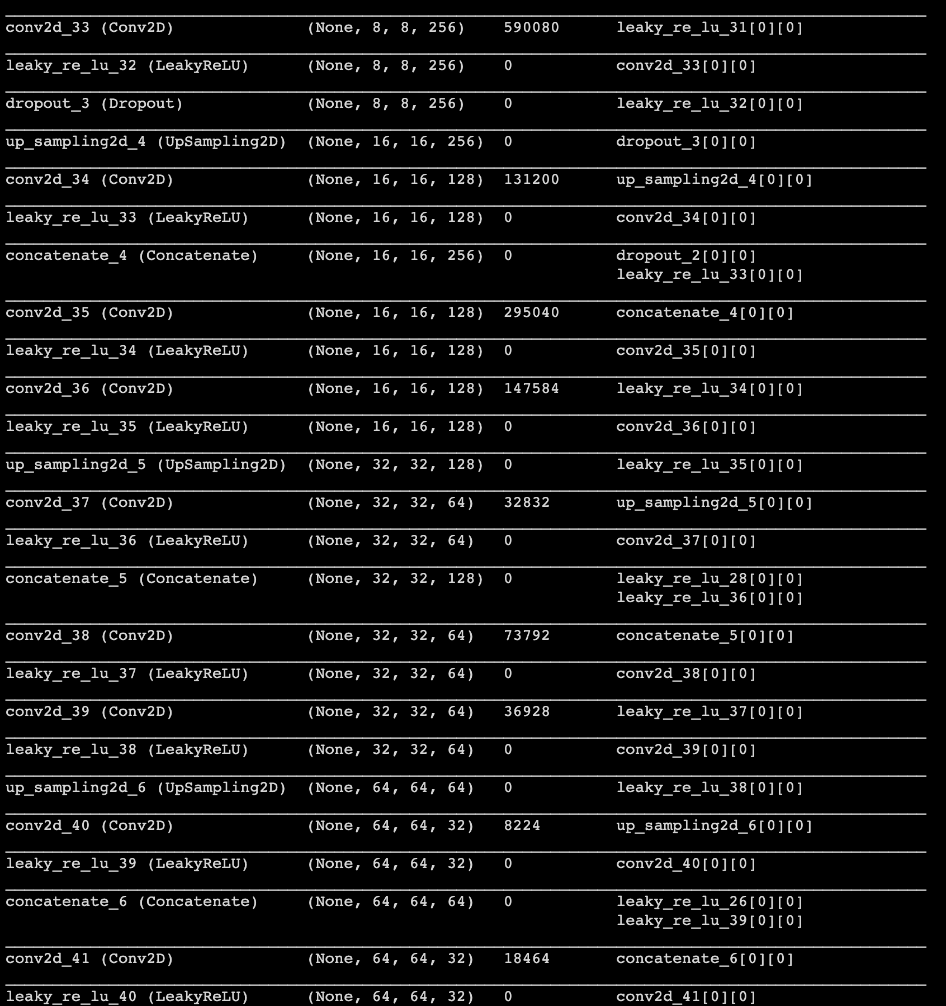
Approach / Solution
Model :

Slide 5
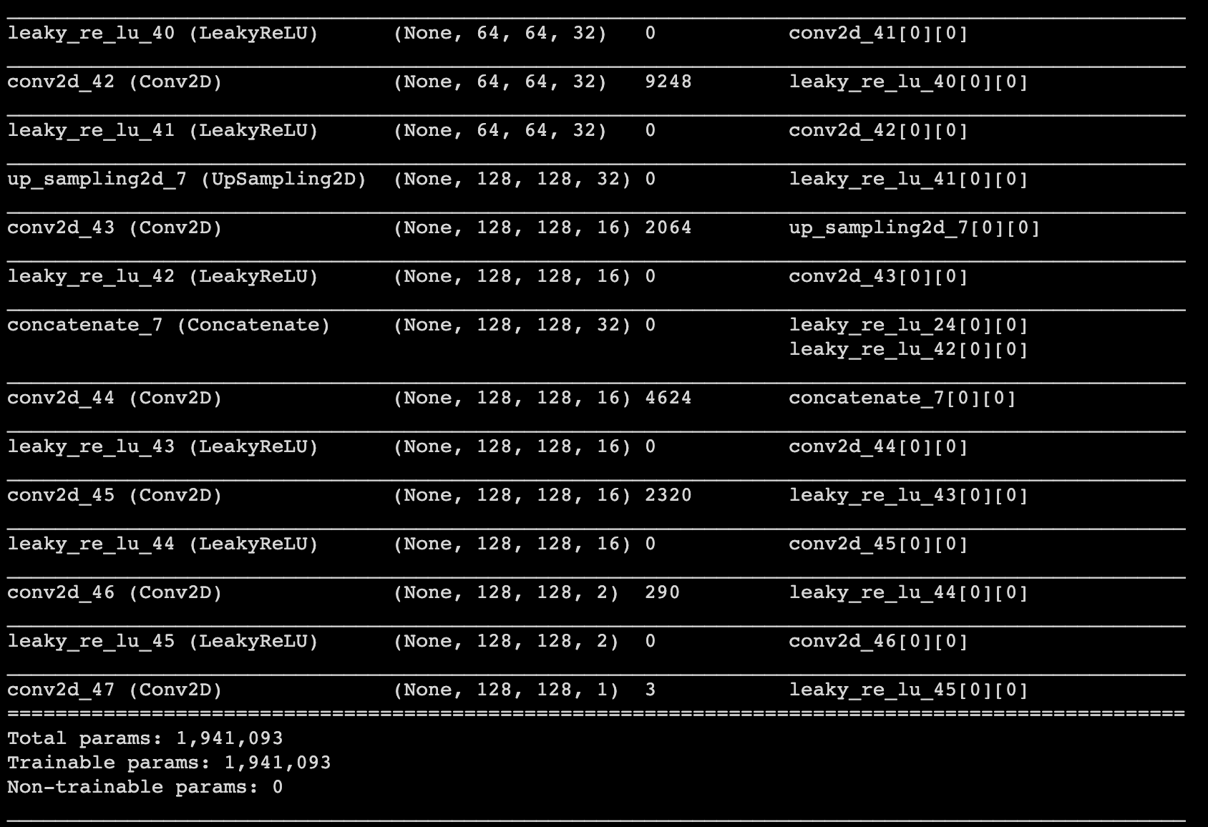
Approach / Solution
Model :
Total Number of Trainable Parameters:
19,41,093 or 1,941,093
Model Architecture - UNet
Activation Function - Leaky ReLU
Metrics Used: MAE(Mean Absolute Error)

Slide 6
Dataset(s) Analysis / Description
Dataset Capture / Preparation / Generation :
We used UrbanSound8K dataset containing 10 classes of 8732 noises downloaded from the UrbanSound official website.
Used MUSDB 18 Dataset containing 22641 .stem.mp3 files which can be extracted to four categories. This dataset is open and available on MUSDB website.
The stem files have been run using stempeg library to generate four files out of each file in dataset.
Dataset Understanding / Analysis :
We took UrbanSound8K dataset for audio classification.
The dataset has ten categories of sound which are available in the form of wav files.
Using MUSDB 18 data for better understanding of the audio separation.
In MUSDB Dataset each file is listed as a .stem.mp3 file from which should extract the files.
Dataset Pre-Processing / Related Challenges (if any) :
Facing Session Timeout Issues (Google Colab). We had to run multiple sessions just to preprocess the dataset.
RAM and GPU processing problems
The GPU and CPU requirements for data preprocessing are not sufficient with available resources.

Slide 7
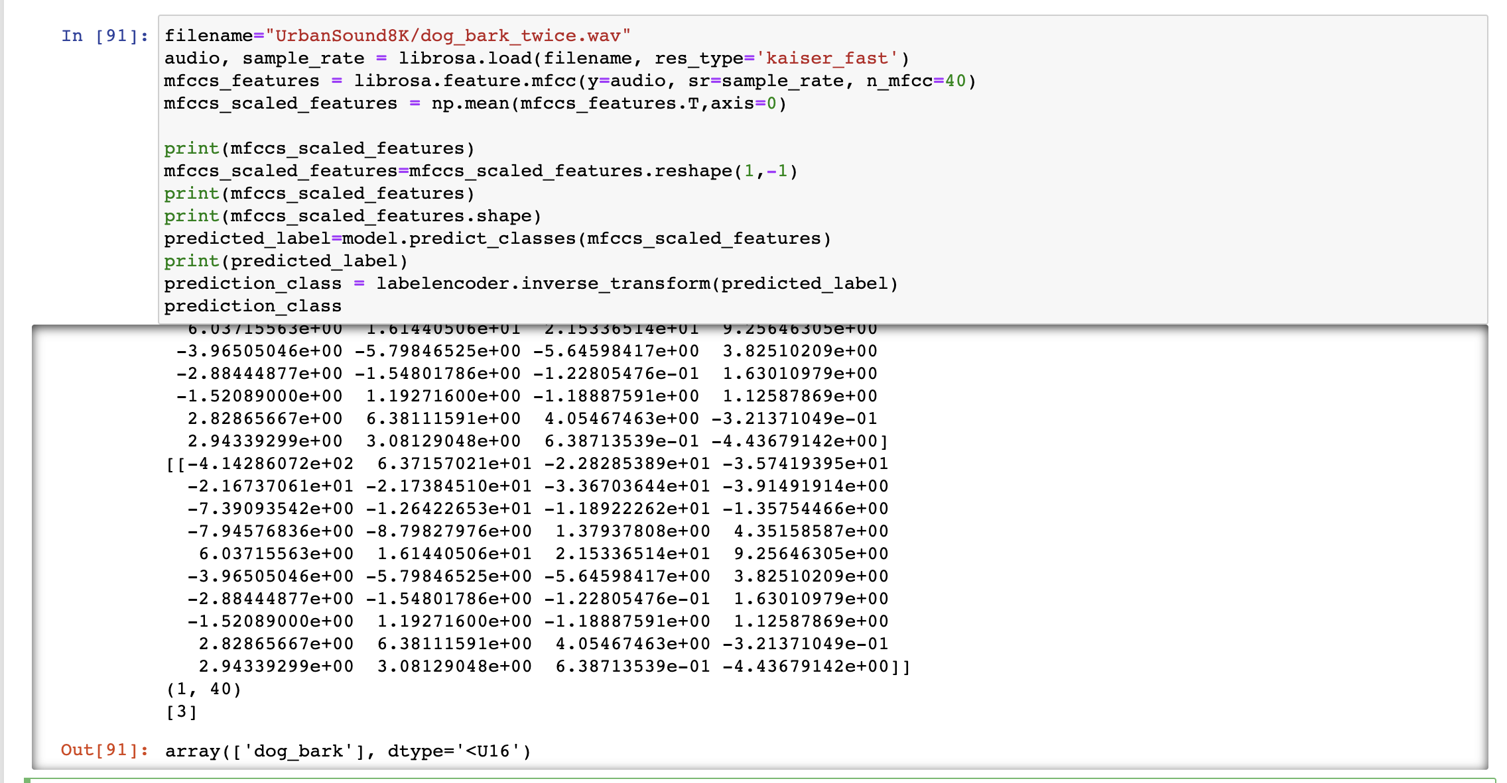
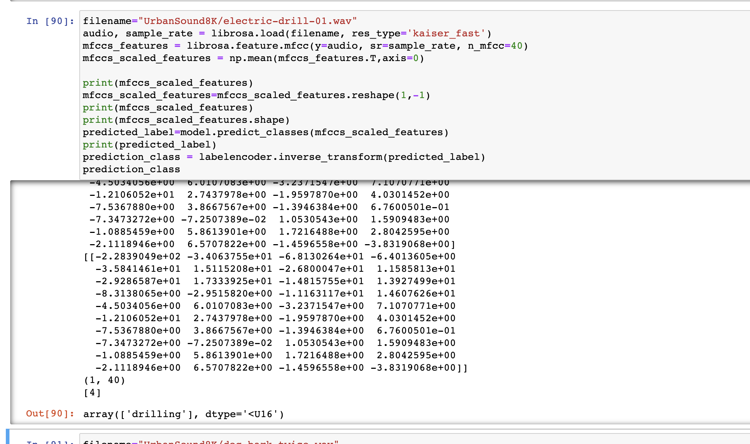
Experimental Results / Observations
Results :
(provide numerical data / bar charts / plots / images / videos / tabulated results etc. Use full slide or multiple slides up to max 3 slides to demonstrate the results)

Slide 8
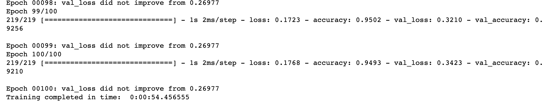
In the Audio Classification Model we have achieved an accuracy of 94% on training data and 92% on testing data.
Major Observations / Conclusions & Challenges :
(provide details about your findings, experimental opinion – Use separate slide if necessary)

Slide 9
Experimental Results / Observations
We obtained a mean absolute loss of mae = 0.0335.
The training was done with 25 number of epochs.

Slide 10
Deliverable
Final Deliverables :
(Discuss in the form of bullets, what are the next steps to complete the solution, any road blocks / bottlenecks, any support needed from SRIB)
We were able to train four different models which are able to separate the audio into voice, bass, others and drums.
Due to sample rate restrictions, a little noise is added in the output.
Guitar tones are not completely removed in the output due to less availability of data.
IP / Paper Publication Plan :
(Details of papers / patentable ideas / innovative aspects that can lead to patentable ideas)
Sample rates and soft parameters can be retuned to get a good audio STFT which can improve the results. The sample rate we took is 8000Hz, while taking the same to 44KHz can improve the performance.
Taking Mel spectrograms in place of stft can improve the predictions.
Implementation of Bidirectional LSTMs for audio source separation.
KPIs delivered/Expectations Met:
(Planned Expectations shared in Work-let vs Delivered Results)
We were able to separate given audio into four categories using the STFT spectrograms.

Slide 11
Work-let Closure Details
Code Upload details:
Items | Details
KLOC | 1872
Model and Algorithm details | UNet Architecture
Is Mid review, end review report uploaded on Git ? | YES
Link for Git | https://github.ecodesamsung.com/SRIB-PRISM/IIITK_OD91IIITK_Audio_Source_Separation
Note: If data uploaded on google drive, access to be shared to prism.srib@gmail.com

Slide 12
Work-let Closure Details
Data details (if applicable):
Items | Data folder 1 | Data folder 2
Name & Type of Data (Audio/Image/Video) | UrbanSound8K(Audio) | MUSDB 18
Number of data points | 8732 | 22641
Source of Data (self collected, Scrapped, available on open source) | Available on Open Source | Available on Open Source
Google drive link/ website to access data | https://urbansounddataset.weebly.com/urbansound8k.html | https://sigsep.github.io/datasets/musdb.html#musdb18-compressed-stems https://drive.google.com/drive/folders/1bOJ75hZKPKK5tn3d5GtiqJYmi7APRymp?usp=sharing
Note: If data uploaded on google drive, access to be shared to prism.srib@gmail.com

Slide 13
Thank you

